Slide 1
Thesis update
2025/2/24

Slide 2
Agenda
Data
Experiment
Measurement*
Derive equation

Slide 3
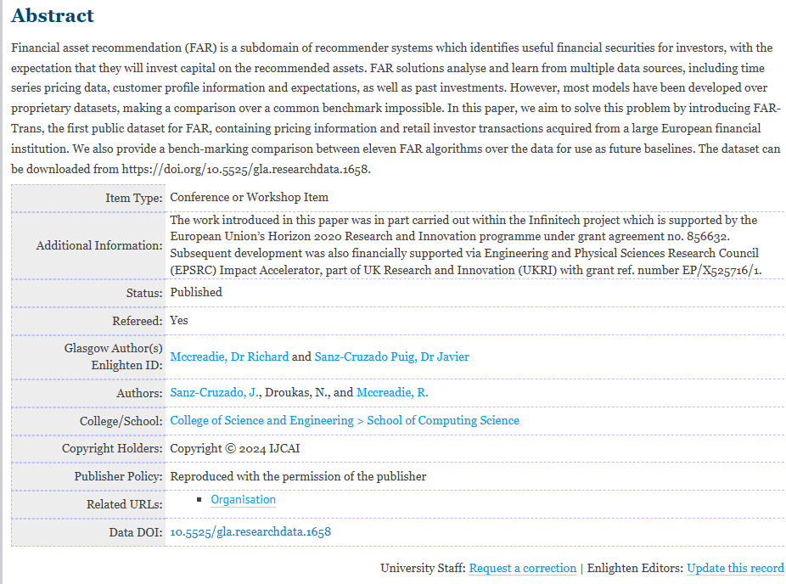
FAR-Trans: An Investment Dataset for Financial Asset Recommendation
FAR-Trans: An Investment Dataset for Financial Asset Recommendation - Enlighten Publications

Slide 4
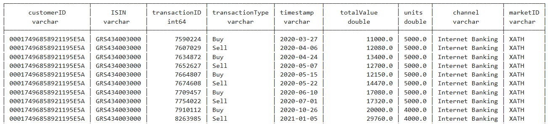
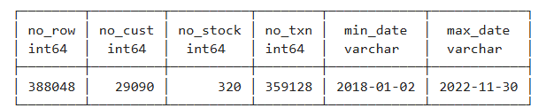
Transaction with ISIN code and Customer ID

Slide 5
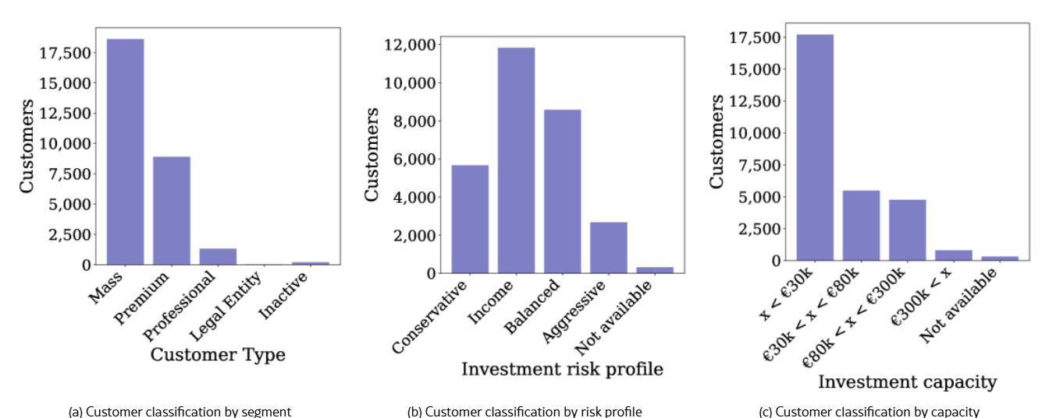
Customer Risk Profile: Parameter for Behavioral portfolio optimization

Slide 6
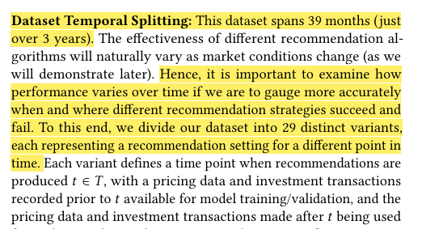
5-Fold Forward Chaining CV (User-Item)
201801 | … | 201912 | 202006 | 202012 | 202106 | 202112 | 202206
Train |  |  | Val
Train |  |  |  | Val
Train |  |  |  |  | Val
Train |  |  |  |  |  | Val
Train |  |  |  |  |  |  | Val
Avg. MAP@K

Slide 7
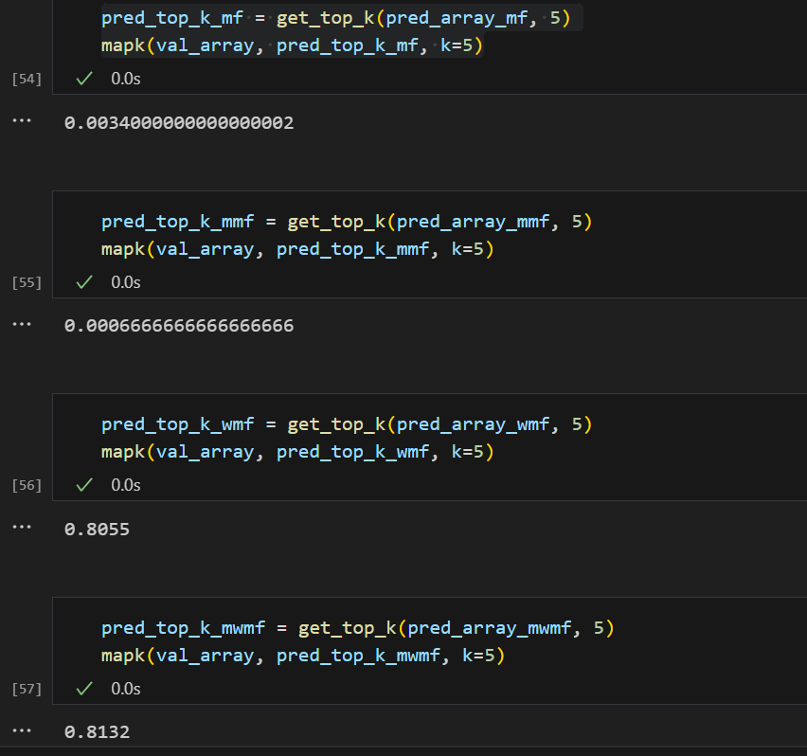
Measurement
Transactional based
  MAP@K
Profit based
  ROI, Sharpe ratio …

Slide 8
Equation (see cf_model.py)
SGD MF (Done)
SGD Mean MF (Done)
SGD WMF (Done)
SGD Mean WMF (Done)
SGD Mean-Variance MF (TBD)
SGD Mean-Variance-Prospect-Theory MF (TBD)
SGD Mean-Variance WMF (TBD)
SGD Mean-Variance-Prospect-Theory WMF (TBD)

Slide 9

Equation
$$\min_{p_{u}, q_{i}}{c_{ui}{\left(y_{ui}−p_{u}q_{i}\right)}^{2}+{λ_{L2}(\left||p_{u}|\right|}^{2}+{\left||q_{i}|\right|}^{2})}$$
$$\min_{p_{u}, q_{i}}{c_{ui}{\left(y_{ui}−p_{u}q_{i}\right)}^{2}{−λ_{MV}\left(p_{u}q_{i}μ_{i}\right)+λ_{L2}(\left||p_{u}|\right|}^{2}+{\left||q_{i}|\right|}^{2})}$$
(Mean)
$$\min_{p_{u}, q_{i}}{c_{ui}{\left(y_{ui}−p_{u}q_{i}\right)}^{2}{−λ_{MV}\left(p_{u}q_{i}μ_{i}\right)+{λ_{MV}\left({(p}_{u}q_{i}\right)}^{2}σ_{i}^{2}+p_{u}q_{i}Σ_{j:j≠i}p_{u}q_{j}σ_{uj}){+ λ}_{L2}(\left||p_{u}|\right|}^{2}+{\left||q_{i}|\right|}^{2})}$$
(Mean)
(Variance-Covariance)
$$\min_{p_{u}, q_{i}}{c_{ui}{\left(y_{ui}−p_{u}q_{i}\right)}^{2}{−λ_{MV}\left(p_{u}q_{i}μ_{i}\right)+{λ_{MV}\left({(p}_{u}q_{i}\right)}^{2}σ_{i}^{2}+p_{u}q_{i}Σ_{j:j≠i}p_{u}q_{j}σ_{uj}){−λ_{PT}\left(p_{u}q_{i}π_{ui}V_{ui}\right)+ λ}_{L2}(\left||p_{u}|\right|}^{2}+{\left||q_{i}|\right|}^{2})}$$
(Mean)
(Variance-Covariance)
(Prospect)
or any theory..

Slide 10

Equation (p_u)
$$\frac{dL}{dp_{u}}=−2c_{ui}\left(y_{ui}−p_{u}q_{i}\right)q_{i}−{λ_{MV}(q}_{i}μ_{i})+λ_{MV}(2p_{u}q_{i}^{2}σ_{i}^{2}+2p_{u}q_{i}∑q_{j}σ_{uj})−{λ_{PT}(q}_{i}π_{ui}V_{ui}){+ λ}_{L2}(2p_{u})$$
Take -1/2
$$\frac{dL}{dp_{u}}=c_{ui}\left(y_{ui}−p_{u}q_{i}\right)q_{i}+λ_{MV}\frac{1}{2}q_{i}μ_{i}−λ_{MV}(p_{u}q_{i}^{2}σ_{i}^{2}−p_{u}q_{i}∑q_{j}σ_{uj})+{λ_{PT}\frac{1}{2}q}_{i}π_{ui}V_{ui}−λ_{L2}p_{u}$$
$$X=X−lr∗\frac{d}{dX}f(X)$$
$$X=X+ lr∗c_{ui}\left(y_{ui}−p_{u}q_{i}\right)q_{i}+λ_{MV}\frac{1}{2}q_{i}μ_{i}−λ_{MV}(p_{u}q_{i}^{2}σ_{i}^{2}−p_{u}q_{i}∑q_{j}σ_{uj})+{λ_{PT}\frac{1}{2}q}_{i}π_{ui}V_{ui}−λ_{L2}p_{u}$$

Slide 11
Equation (q_i)
$$\frac{dL}{dp_{u}}=−2c_{ui}\left(y_{ui}−p_{u}q_{i}\right)p_{u}−{λ_{MV}(p}_{u}μ_{i})+λ_{MV}(2p_{u}^{2}q_{i}σ_{i}^{2}+p_{u}^{2}∑q_{j}σ_{uj})−{λ_{PT}(p}_{u}π_{ui}V_{ui}){+ λ}_{L2}(2q_{i})$$
Take -1/2
$$\frac{dL}{dp_{u}}=c_{ui}\left(y_{ui}−p_{u}q_{i}\right)p_{u}+λ_{MV}\frac{1}{2}p_{u}μ_{i}−λ_{MV}(p_{u}^{2}q_{i}σ_{i}^{2}−{\frac{1}{2}p}_{u}^{2}∑q_{j}σ_{uj})+{λ_{PT}\frac{1}{2}p}_{u}π_{ui}V_{ui}{− λ}_{L2}q_{i}$$
$$X=X−lr∗\frac{d}{dX}f(X)$$
$$X=X+ lr∗c_{ui}\left(y_{ui}−p_{u}q_{i}\right)p_{u}+λ_{MV}\frac{1}{2}p_{u}μ_{i}−λ_{MV}(p_{u}^{2}q_{i}σ_{i}^{2}−{\frac{1}{2}p}_{u}^{2}∑q_{j}σ_{uj})+{λ_{PT}\frac{1}{2}p}_{u}π_{ui}V_{ui}{− λ}_{L2}q_{i}$$

Slide 12
Final gradient descent equation
$$X_{pu}=X_{pu}+ lr∗c_{ui}\left(y_{ui}−p_{u}q_{i}\right)q_{i}−λ_{MV}p_{u}q_{i}^{2}σ_{i}^{2}−λ_{MV}p_{u}q_{i}∑q_{j}σ_{uj}+λ_{MV}\frac{1}{2}q_{i}μ_{i}+{λ_{PT}\frac{1}{2}q}_{i}π_{ui}V_{ui}−λ_{L2}p_{u}$$
$$X_{qi}=X_{qi}+ lr∗c_{ui}\left(y_{ui}−p_{u}q_{i}\right)p_{u}−λ_{MV}p_{u}^{2}q_{i}σ_{i}^{2}−{λ_{MV}\frac{1}{2}p}_{u}^{2}∑q_{j}σ_{uj}+λ_{MV}\frac{1}{2}p_{u}μ_{i}{{+λ}_{PT}\frac{1}{2}p}_{u}π_{ui}V_{ui}{− λ}_{L2}q_{i}$$

